Slide 1

Zomato Order and Restaurant Analysis.
-G.Manasa

Slide 2
Upload Dataset into mysql.
Created a new database zomatodb.
Created tables zomato_restaurants and zomato_orders.
Imported data into the tables.

Slide 3
Basic data cleaning.
No duplicate records found.
No null values found.

Slide 4
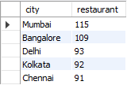
Number of Restaurants in each city.
5 cities displayed
Mumbai city is having the highest number of restaurants.
Chennai is having the least number of restaurants.

Slide 5
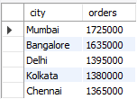
Top 5 cities with highest number of orders.
Mumbai,Bangalore,Delhi,Kolkata, Chennai are the top 5 cities.
Mumbai is the top city with highest number of orders.

Slide 6
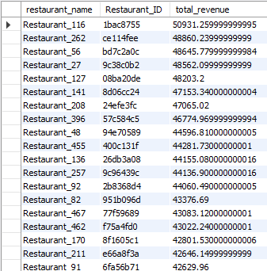
Total revenue generated by each restaurant.
Restaurant_116 is generating highest revenue, i.e 50,931
Restaurant_249 is generating lowest revenue, i.e 13,649

Slide 7
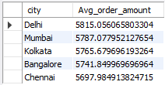
Average order amount for each city.
Delhi is having the highest average order amount.
Chennai is having the lowest average order amount.

Slide 8
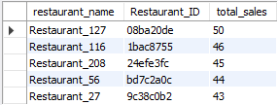
Top 5 restaurants with the highest total sales.
Restaurant_127 is having the highest total sales.

Slide 9
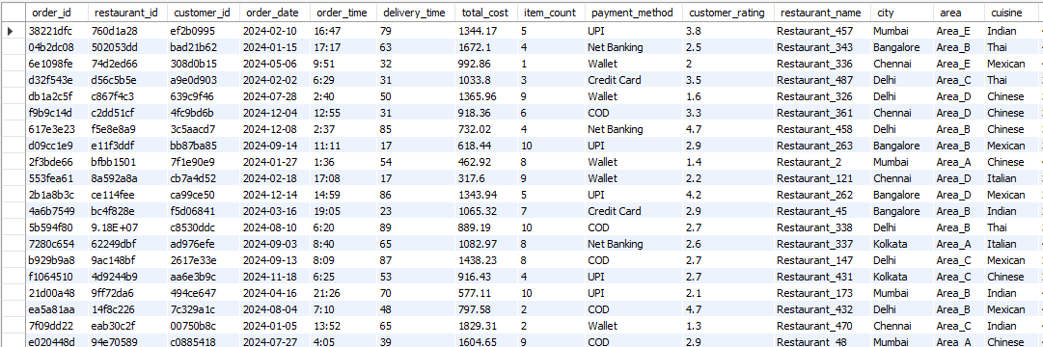
Joined orders and restaurants table.

Slide 10
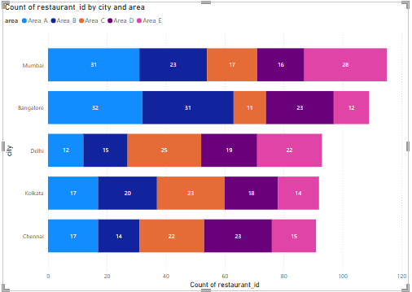
Number of Restaurants per city
Mumbai is having the highest restaurants.
Identified trends such as:
High restaurant density areas.
Underrepresented locations.

Slide 11
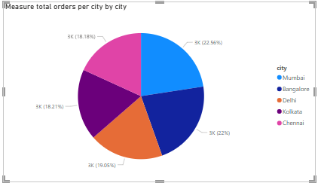
Percentage of orders from different cities.
Distributed orders among the cities.
Mumbai is having the highest orders.

Slide 12
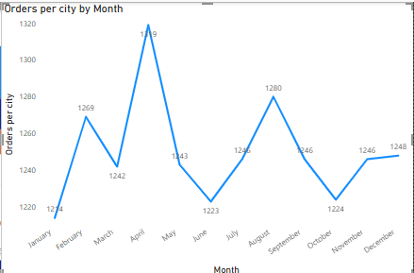
Order amount trends over time.
Extracted date-wise order amounts from the dataset.
April month is having the highest and January month is having lowest order values.

Slide 13
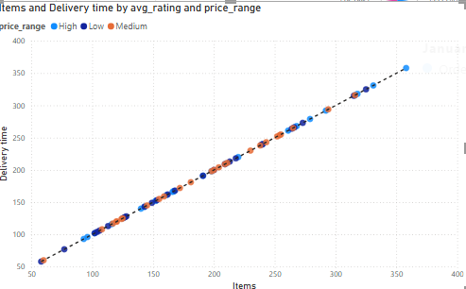
Correlation of factors affecting average rating.
Identified correlations between different factors to understand customer preferences.
Positive trends.

Slide 14
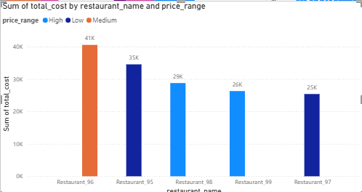
Top 5 restaurants by total sales.
Identified top 5 restaurants based on their sales.
Restaurant_96 is the top 1 restaurant with medium price range.

Slide 15
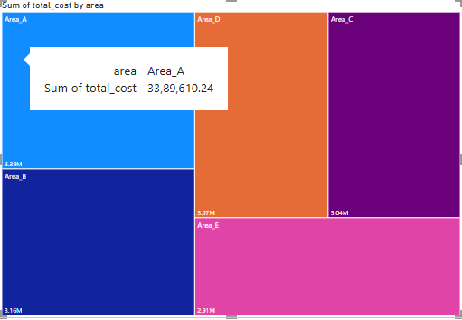
Revenue by area.
Identified high and low revenue areas.
Area A is having the highest revenue.

Slide 16
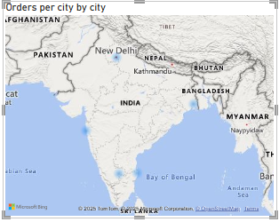
Order density per city.
Identified cities with highest and lowest order values.
Mumbai is having the highest order density.

Slide 17
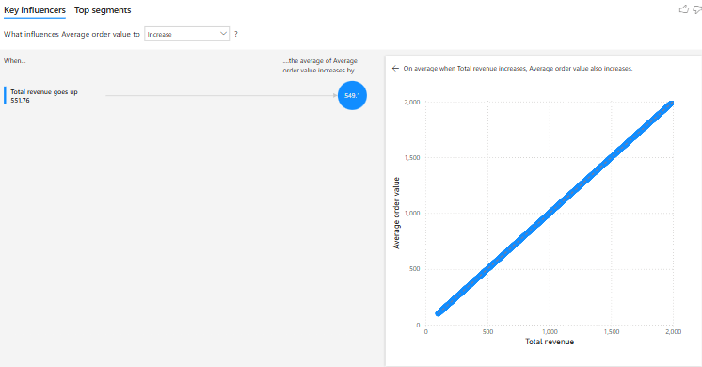
Total revenue and Average order value.
Calculated Total revenue and average order value.
Compared previous period- increase.

Slide 18
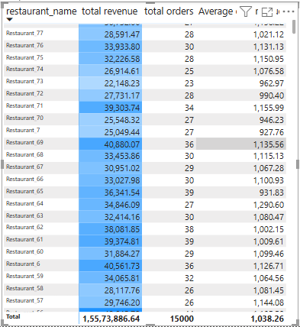
Restaurant-wise sales summary .
Displayed restaurant names,total sales, number of orders and acreage order value.
Identified best and worst performers by applying conditional format.
Added drill-down to filter.

Slide 19
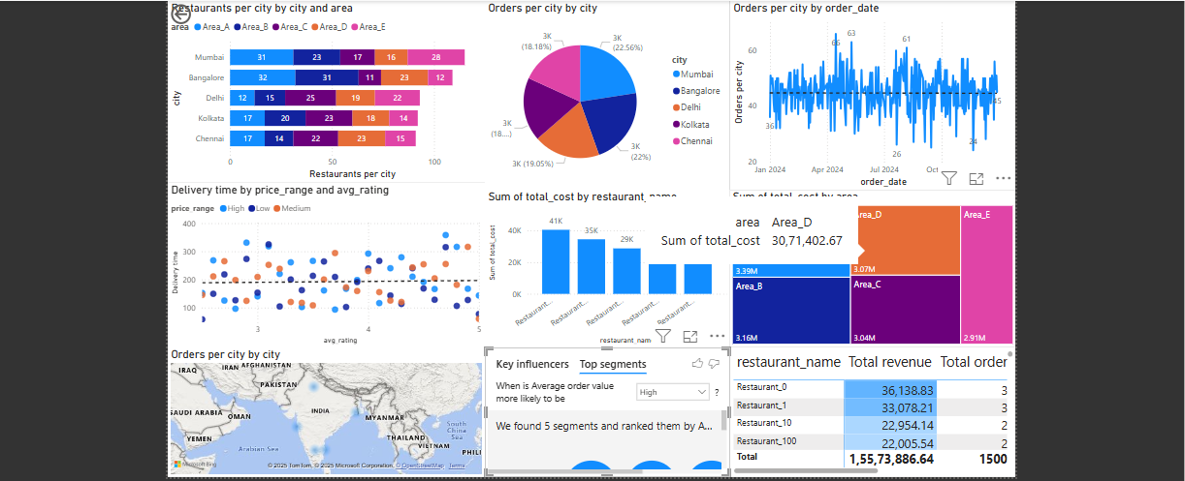
DASHBOARD
Combined all visuals and created a dashboard.

Slide 20


